Slide 1
EAD Update
11/17/2023
New: NFL / NFM
Old: (p)NFH(D2)
Proposed figure panels (excluding color scheme)

Slide 2
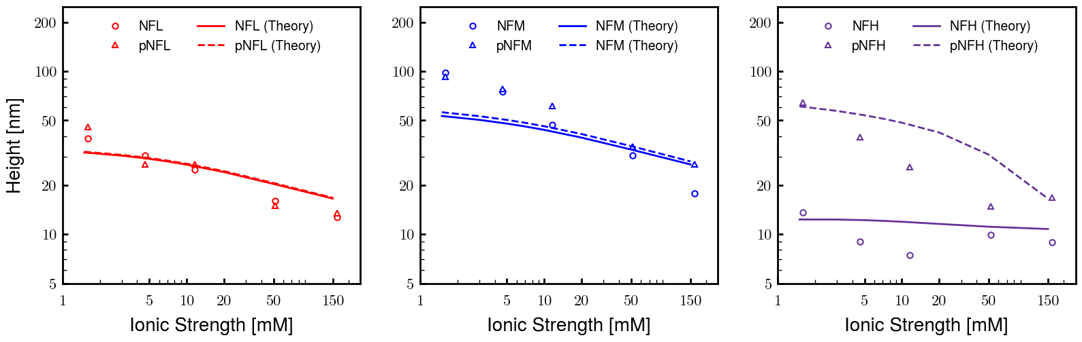
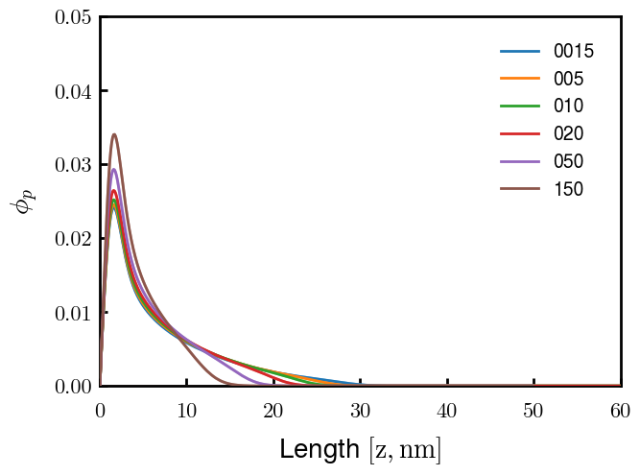
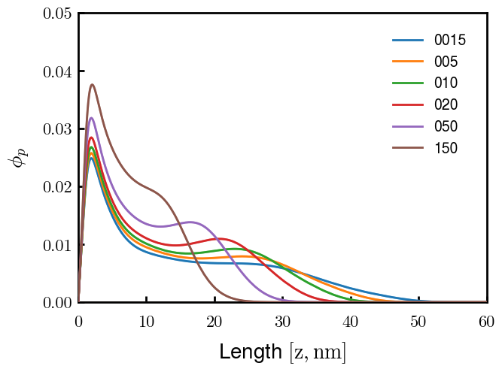
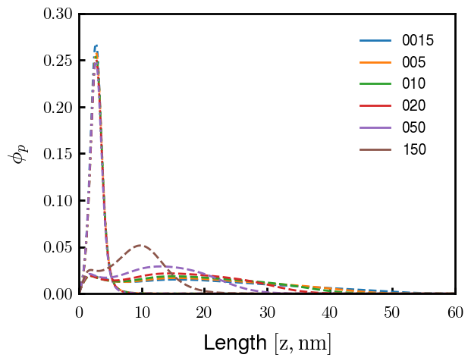
NFL
NFM
NFH
pNFH
b = 0.60 nm, v = 0.05 nm3 for all except pNFH, where v = 0.15 nm3
Phos. valency = -1

Slide 3
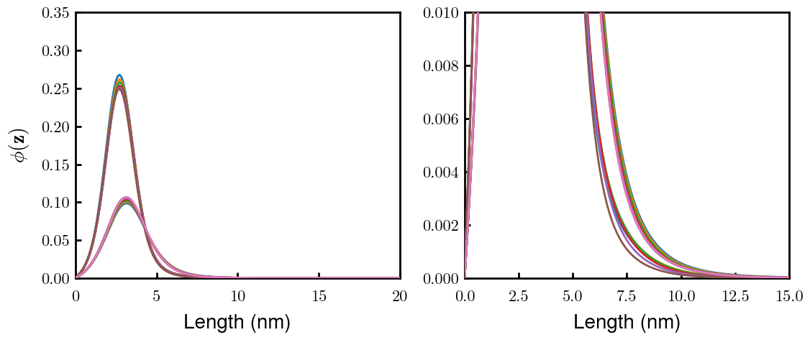
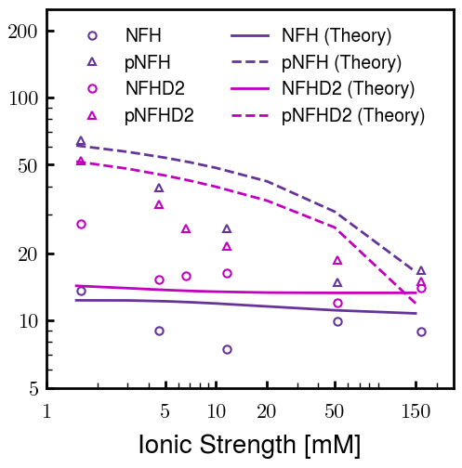
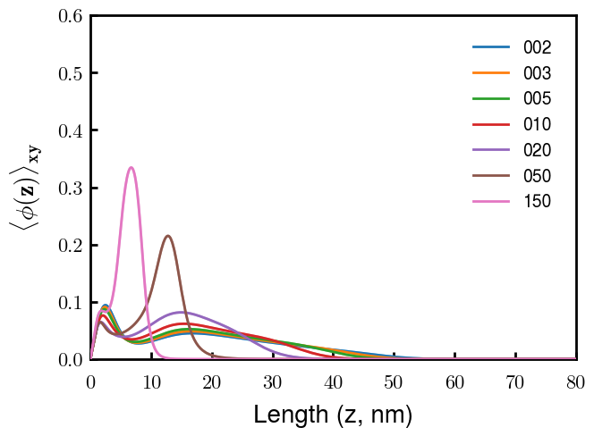
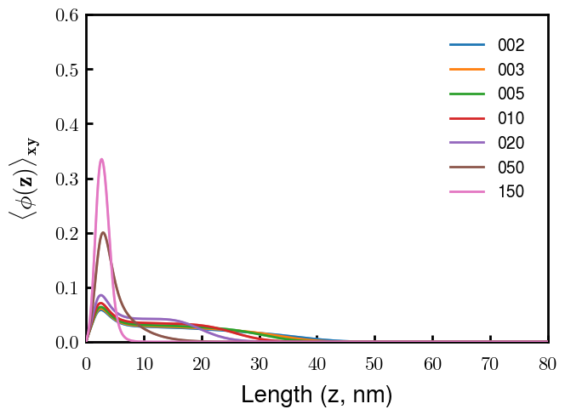
NFH
NFHD2
pNFH
pNFHD2
Legend could definitely be cleaner

